Slide 1

307304 Business Intelligence and Data Mining
Logistic Regression

Slide 2
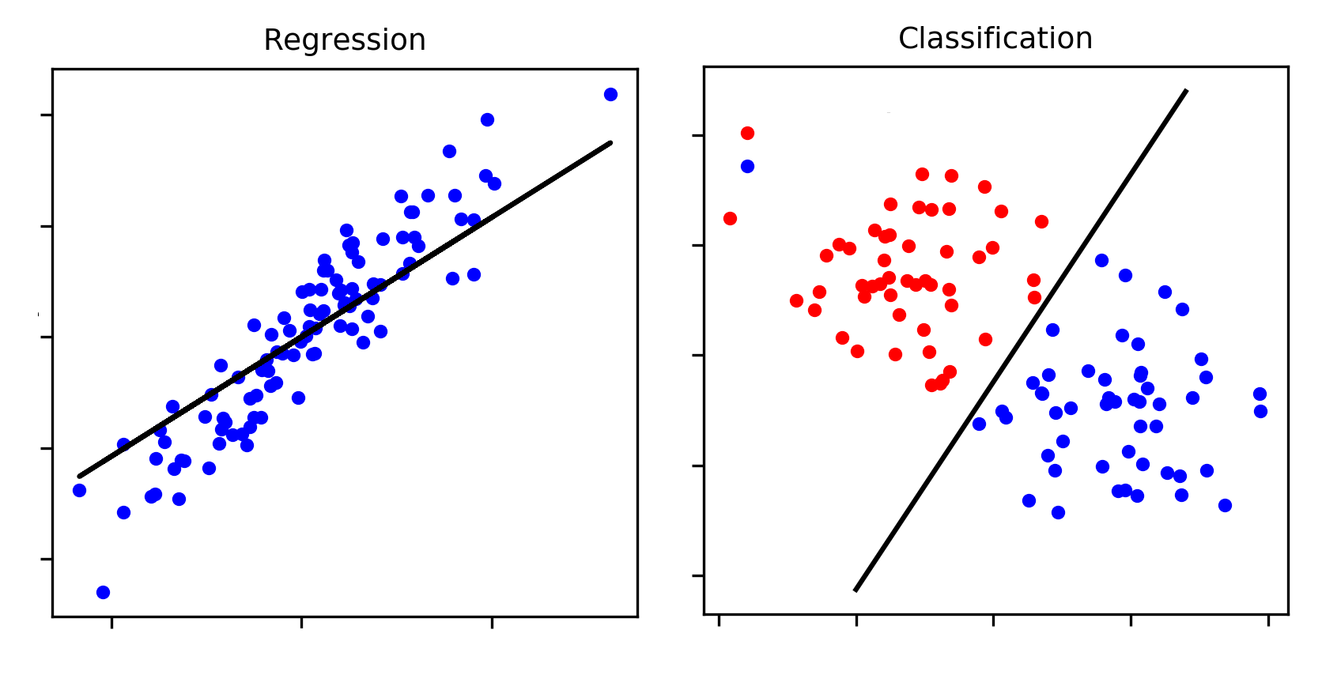
What is Classification?
Classification is a type of supervised learning where the goal is to predict a categorical label (like "yes" or "no") instead of a continuous value.
Examples:
Predicting if an email is spam or not
Determining if a customer will make a purchase
Medical diagnosis

Slide 3
Binary Classification Examples
Problem | Example Features
Churn Prediction | Customer tenure, monthly charges, contract type, support calls
Spam Detection | Email subject length, sender reputation, word frequency
Loan Approval | Income, credit score, loan amount, employment status
Fraud Detection | Transaction amount, location, card usage frequency
Disease Diagnosis | Age, symptoms, test results, exposure history

Slide 4
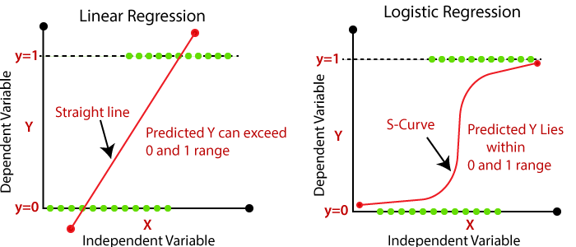
Why Not Linear Regression?
Linear Regression Problems:
Great for predicting continuous numbers (like prices)
Struggles with binary outcomes (yes/no, spam/not spam)
Can predict values outside 0-1 range
Doesn't handle categorical data well
Solution: Logistic Regression

Slide 5
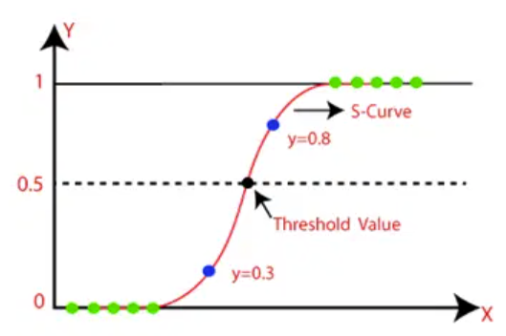

What is Logistic Regression?
Logistic regression predicts the probability that an instance belongs to a certain class.
Key Component: Sigmoid Function
How it works:
Takes any input value
Squeezes it between 0 and 1
Perfect for probability predictions!

Slide 6
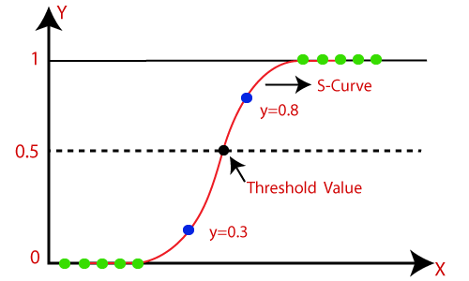
Decision Making
Classification Rules:
If probability > 0.5 → Predict "Yes" (Class 1)
If probability ≤ 0.5 → Predict "No" (Class 0)
Visual Comparison:
Linear Regression: Straight line, can go beyond 0-1
Logistic Regression: S-curve, bounded between 0-1

Slide 7
Dataset Example - Diabetes Prediction
Diabetes Prediction Dataset
Source: National Institute of Diabetes and Digestive and Kidney Diseases
Population: Pima Indian females, 21+ years old
Goal: Predict diabetes based on diagnostic measurements
Features:
Pregnancies, Glucose, Blood Pressure, Skin Thickness
Insulin, BMI, Diabetes Pedigree Function, Age
Target: Outcome (0 = No Diabetes, 1 = Diabetes)
 | Pregnancies | Glucose | BloodPressure | SkinThickness | Insulin | BMI | DiabetesPedigreeFunction | Age | Outcome
0 | 6 | 148 | 72 | 35 | 0 | 33.6 | 0.627 | 50 | 1
1 | 1 | 85 | 66 | 29 | 0 | 26.6 | 0.351 | 31 | 0
2 | 8 | 183 | 64 | 0 | 0 | 23.3 | 0.672 | 32 | 1

Slide 8
Implementation Steps
5-Step Process:
Load the Data
Split into training and testing datasets
Define the classification model
Fit the model to training data
Make predictions and test performance

Slide 9
Diabetes Prediction
import pandas as pd
from sklearn.model_selection import train_test_split
from sklearn.linear_model import LogisticRegression
# Load the dataset from the URL
url = "https://raw.githubusercontent.com/msfasha/307304-Data-Mining/main/20242/datasets/diabetes.csv"
data = pd.read_csv(url)
# Define features (X) and target (y)
X = data[['Pregnancies', 'Glucose', 'BloodPressure', 'SkinThickness', 'Insulin', 'BMI','DiabetesPedigreeFunction','Age']]
y = data['Outcome']
# Split the data
X_train, X_test, y_train, y_test = train_test_split(X, y, test_size=0.2)
# Train logistic regression model
model = LogisticRegression(max_iter=200) # Increase iterations to 200
model.fit(X_train, y_train)
# Predict on test data
predictions = model.predict(X_test)
print("Predictions:", predictions)

Slide 10
Output
Predictions:
Predictions: [1 0 0 0 1 0 0 0 0 0 0 0 0 0 0 0 0 0 0 1 1 0 0 1 0 0 0 1 1 1 0 1 1 0 1 0 0
0 0 0 1 0 1 0 0 1 1 0 1 0 0 0 1 0 0 1 0 0 0 1 0 1 1 0 0 1 0 0 1 0 0 1 0 1
0 0 0 0 0 1 1 0 1 0 0 0 0 1 0 0 1 0 0 0 0 0 0 1 0 0 1 1 0 1 0 0 0 0 0 1 1
0 1 0 0 0 1 0 0 1 1 0 0 0 0 0 0 1 1 1 0 1 0 1 0 0 0 0 1 0 0 0 0 0 0 0 0 0
1 0 0 0 0 0]
Interpretation:
0 = No Diabetes predicted
1 = Diabetes predicted
Model provides binary classification for each patient

Slide 11
Measuring Classification Performance
Confusion Matrix: A table summarizing prediction accuracy
 | Predicted Non-Diabetic | Predicted Diabetic
Actual Non-Diabetic | True Negative (TN) | False Positive (FP)
Actual Diabetic | False Negative (FN) | True Positive (TP)
Medical Context:
TP: Correctly identifies diabetic patient
FP: Misdiagnoses healthy patient as diabetic
TN: Correctly identifies healthy patient
FN: Misses diabetic patient (dangerous!)

